Slide 1

Project Title - Seasonal Agriculture Performance Analysis
[Student Name:- Pratham. Ashish. Kothari
College Name- MCT's Rajiv Gandhi Institute of Technology]
AICTE STU ID : STU685417646c8121750341476

Slide 2

PROBLEM STATEMENT
Agricultural performance is influenced by seasonal variations in environmental conditions, farming practices, resource availability, and market conditions.
However, raw agricultural data does not clearly show how performance changes across seasons or what patterns exist.
Therefore, this project aims to analyze the agricultural dataset to identify seasonal differences, patterns, trends, relationships, and variations in agricultural performance.

Slide 3
This project analyzes agricultural activities across different seasons, geographical areas, and farming conditions. It examines environmental conditions, farming practices, resource usage, crop production, and economic performance to understand how agricultural performance changes between seasons.
The analysis uses data cleaning, statistical techniques, visualization, and comparative analysis to identify seasonal patterns, trends, relationships, significant differences, and unusual variations. The findings are then interpreted to generate evidence-based insights and recommendations for better seasonal agricultural planning.
Project Description

Slide 4

WHO ARE THE END USERS?
Farmers and farm managers – to understand seasonal crop performance and improve farming decisions.
Agricultural planners and government departments – to support evidence-based seasonal agricultural planning.
Agricultural researchers and data analysts – to study seasonal trends, relationships, and variations.
Agribusiness stakeholders – to understand production, resource usage, and economic performance across seasons.
Irrigation and resource-management teams – to analyze seasonal resource requirements and improve resource allocation.

Slide 5

Technology Used
Python – Main programming language for data analysis.
Pandas & NumPy – Data cleaning, preprocessing, aggregation, and numerical analysis.
Matplotlib & Seaborn – Data visualization and graphical analysis.
SciPy – Statistical tests and analysis.
Jupyter Notebook – To perform and document the complete analysis.
Techniques used: Data Cleaning, Exploratory Data Analysis (EDA), Statistical Analysis, Correlation Analysis, Seasonal Comparison, and Data Visualization.

Slide 6
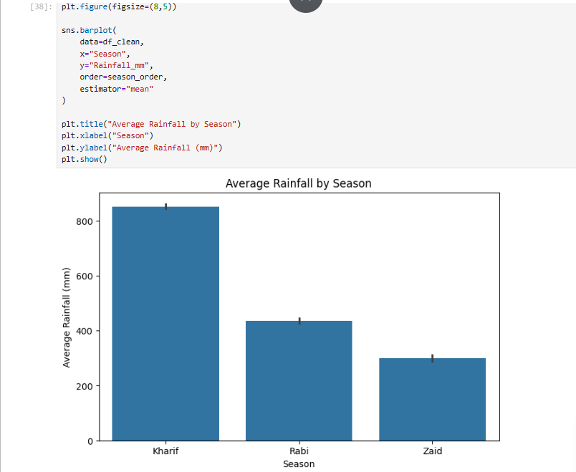
RESULTS

Slide 7
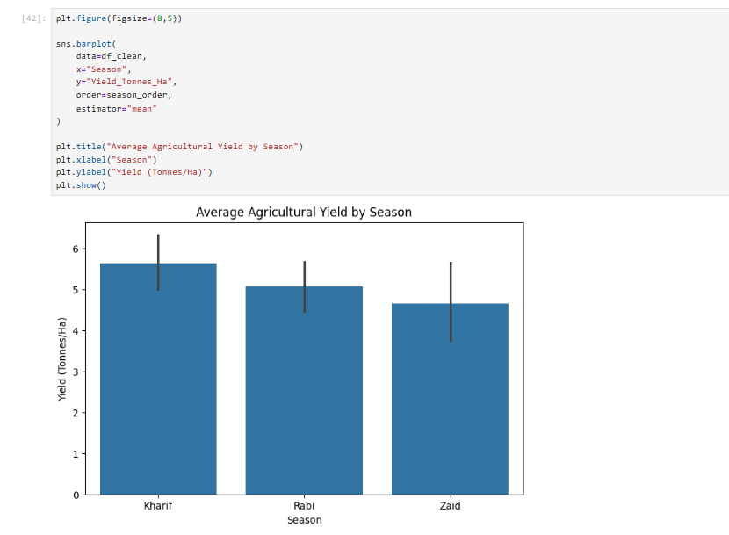
RESULTS

Slide 8
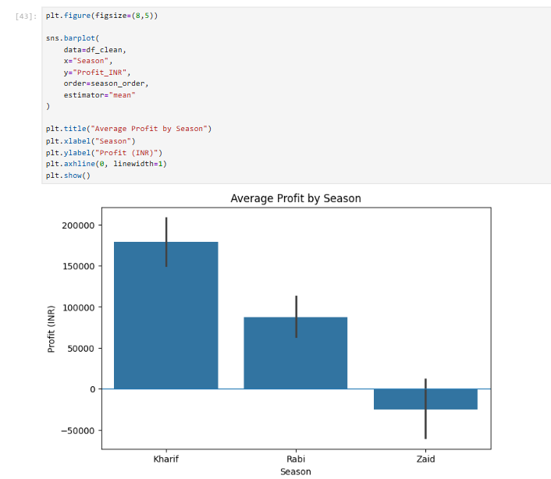
RESULTS

Slide 9
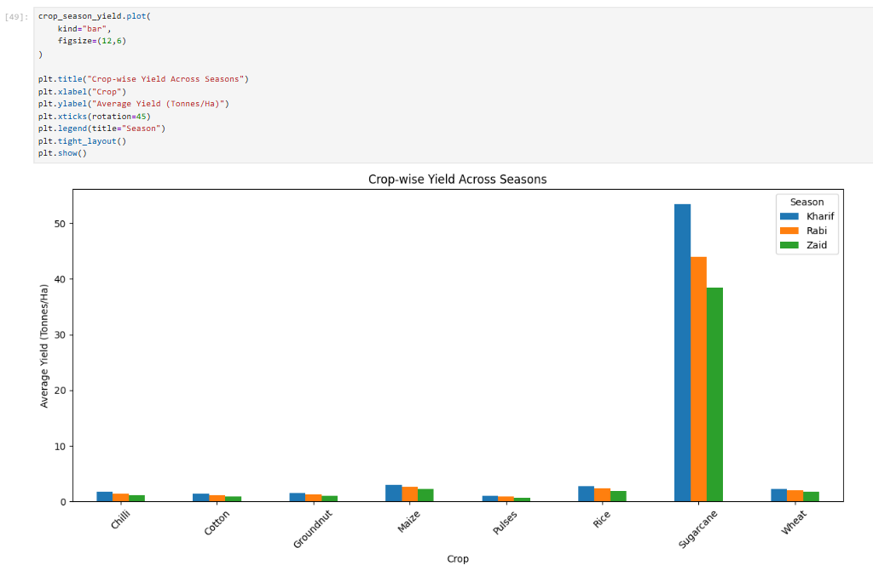
RESULTS

Slide 10
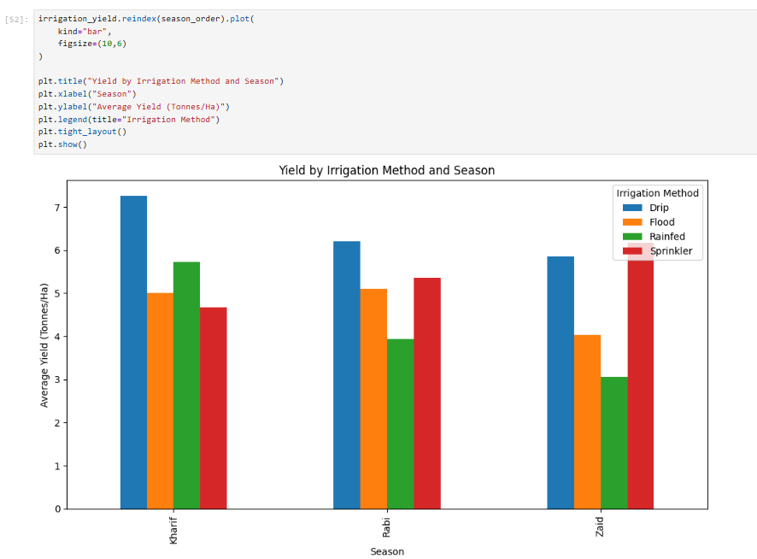
RESULTS

Slide 11
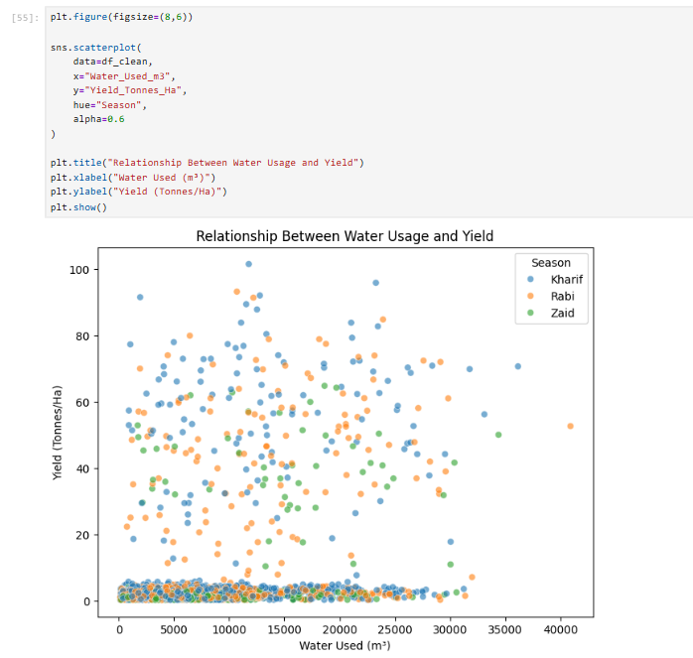
RESULTS

Slide 12
Future scope
Multi-year analysis: Use agricultural data from multiple years to identify long-term seasonal trends.
Predictive analysis: Develop ML models to predict crop yield, production, and profitability for upcoming seasons.
Real-time weather data: Integrate rainfall, temperature, humidity, and other live weather information.
Interactive dashboard: Develop a Power BI or web-based dashboard for real-time seasonal monitoring.
Crop and resource optimization: Recommend suitable crops and optimize water, fertilizer, and pesticide usage based on seasonal conditions.
Advanced regional analysis: Extend the analysis to more regions and districts for better agricultural planning.

Slide 13
GitHub Link
https://github.com/prathamk124/Seasonal_Agriculture_Performance_Analysis

Slide 14

VOIS Course completion certificate - Course name- Data Visualization

Slide 15
Thank you
.
.

